Slide 1

Hansel and Gretel

Slide 2
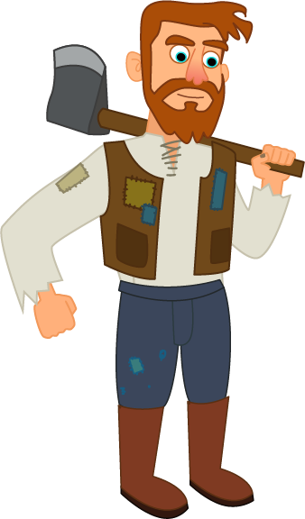
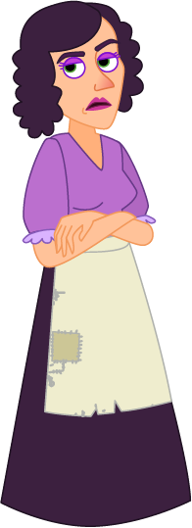

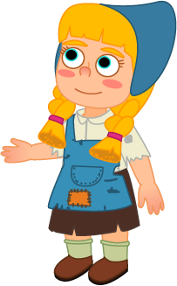
There once lived a poor woodcutter, his and
two -- a called Hansel and a called Gretel.
Hansel
Gretel

Slide 3

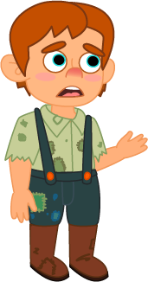

The woodcutter and his did not have enough food for their and daughter. So, they decided to leave them deep in the forest. Hansel and Gretel overheard this and came up with a plan.

Slide 4
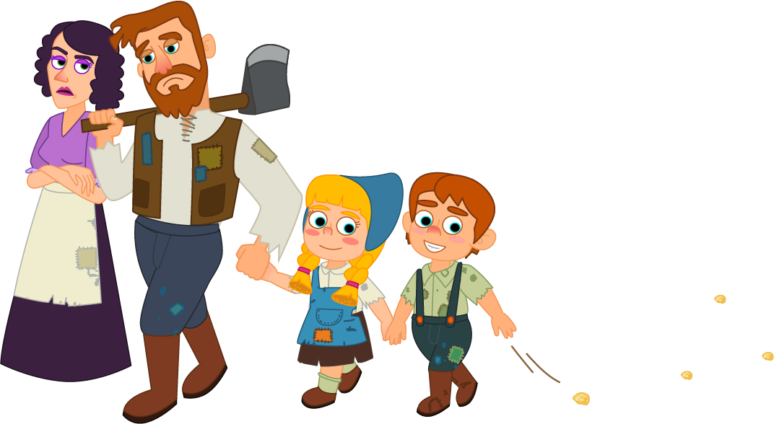
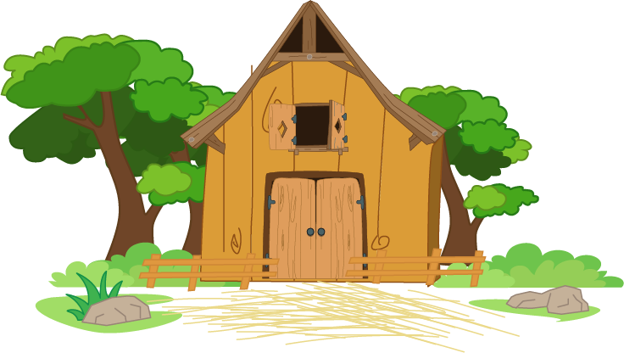
When their took them into the forest, Hansel and Gretel dropped pebbles along the way. Then, they found their way home by following the line of pebbles.

Slide 5

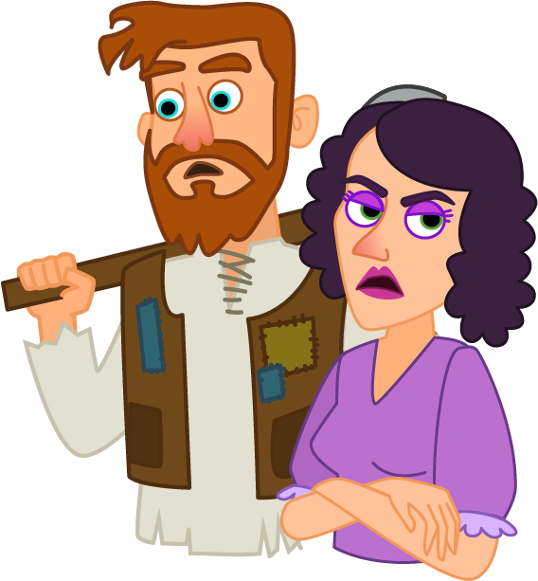
Their and stepmother were surprised to see them back. They decided to take them deeper into the forest once again.

Slide 6
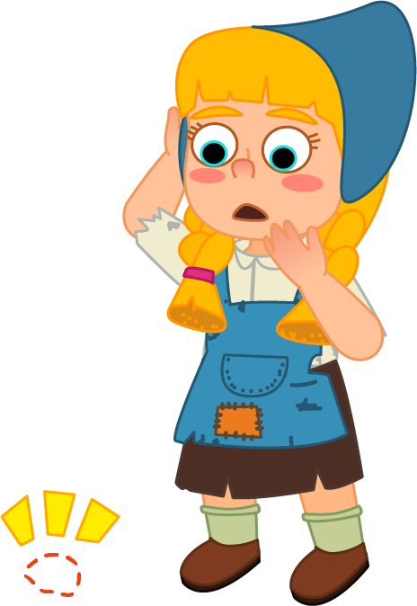
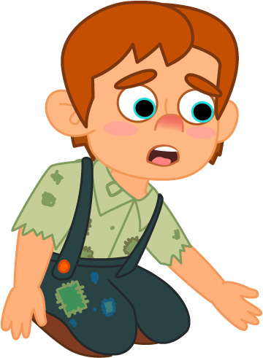


This time, Hansel and Gretel dropped breadcrumbs because their pebbles were taken by their . But sadly, the animals and birds in the forest ate all the crumbs. They were lost in the forest.

Slide 7
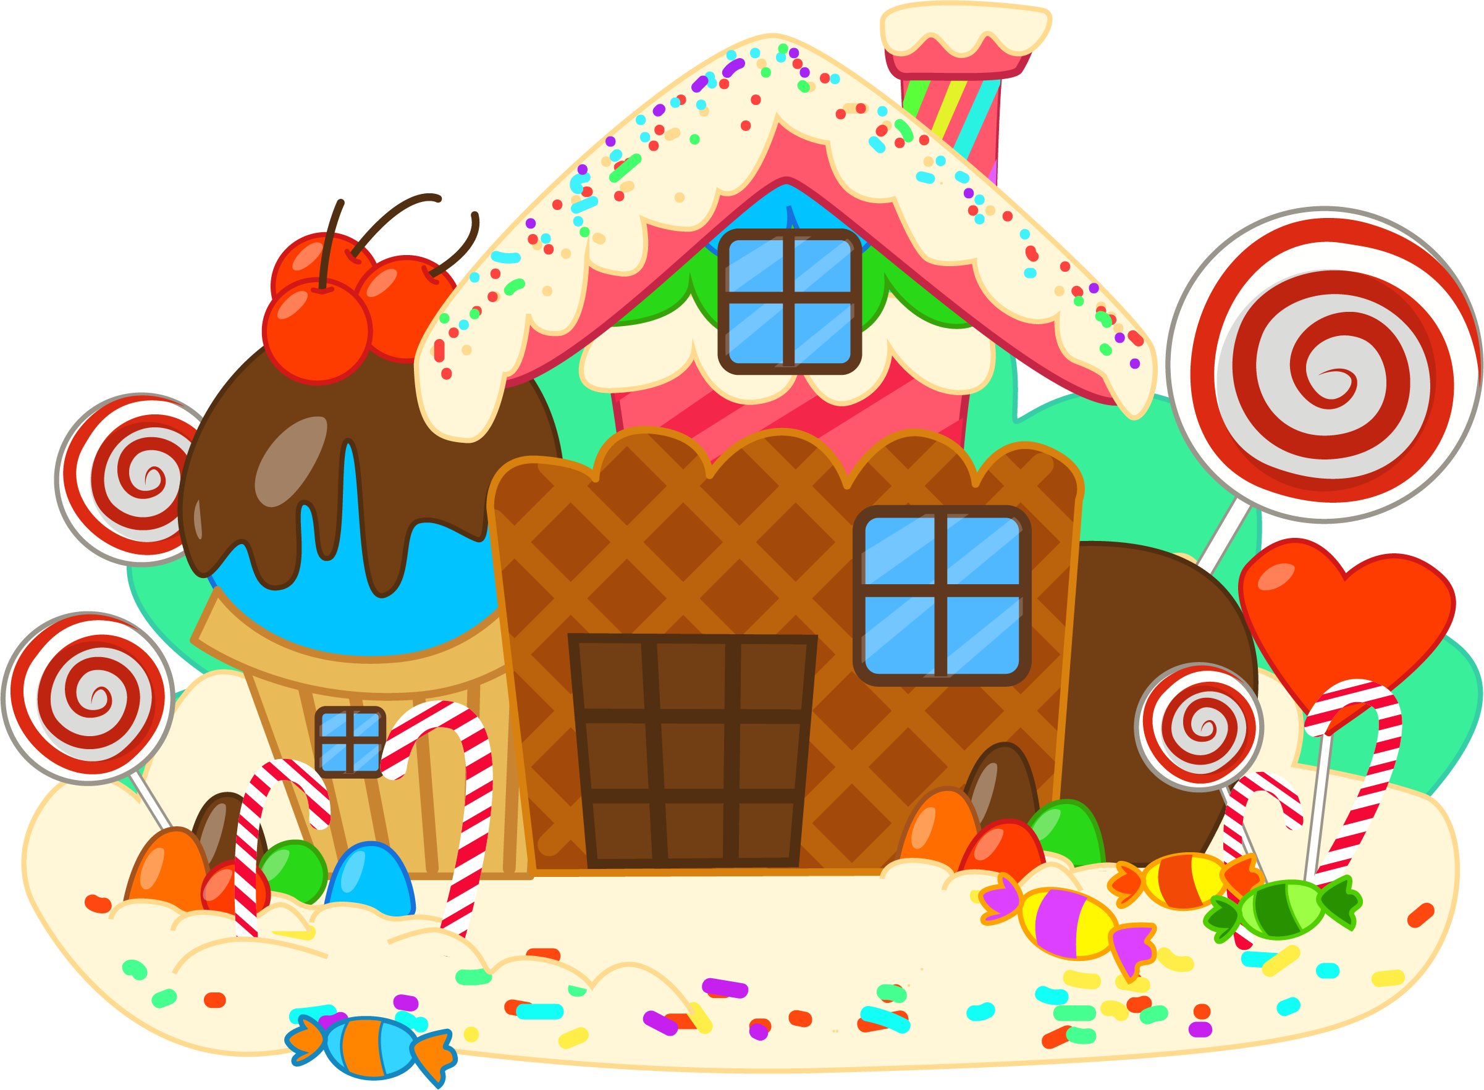
Then they came upon a strange house. It was made of chocolates, candies and cookies.

Slide 8
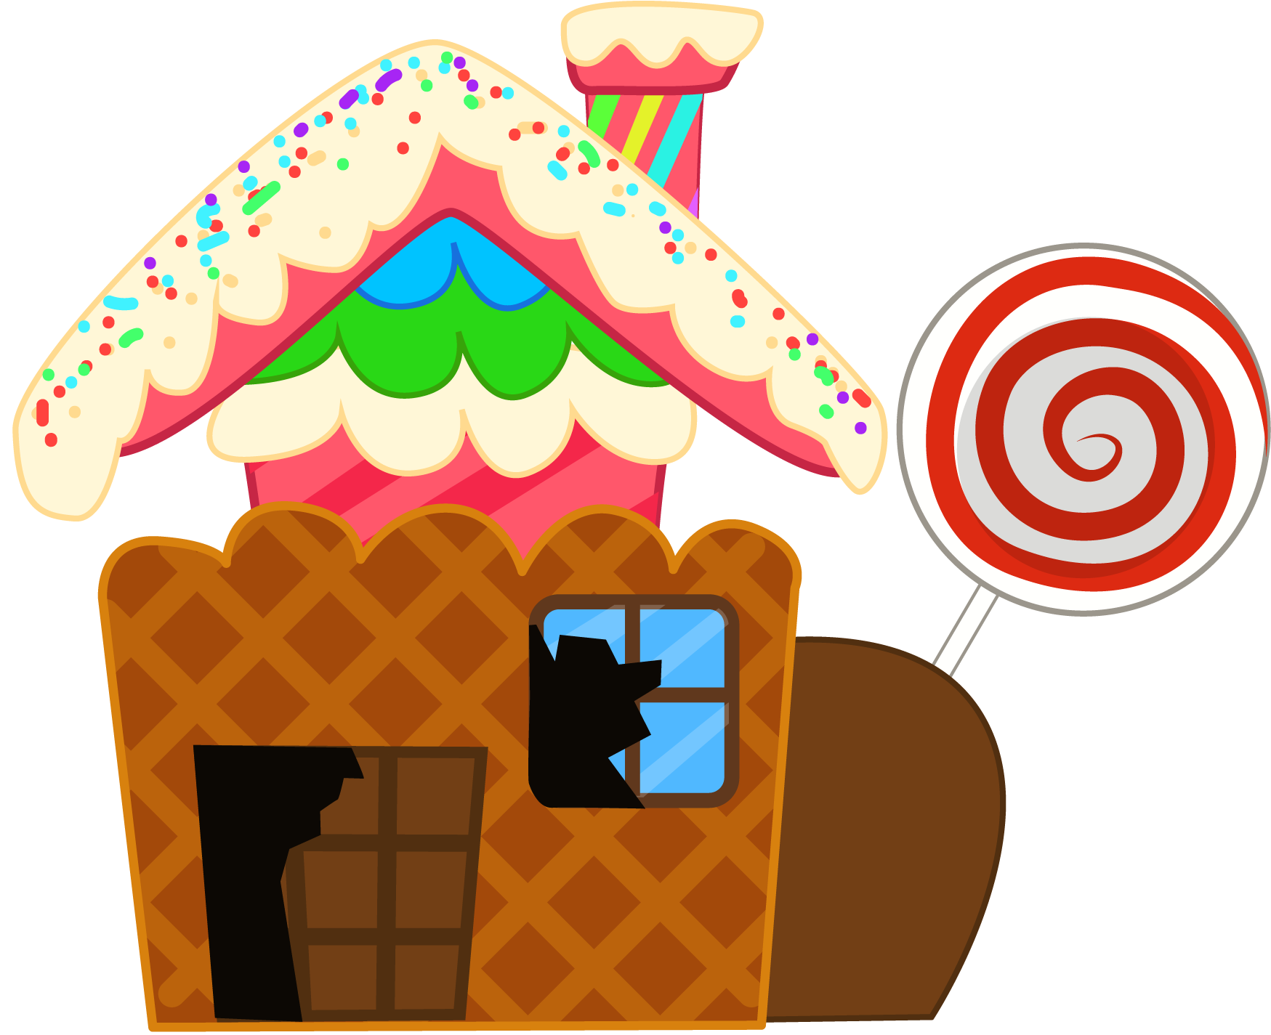
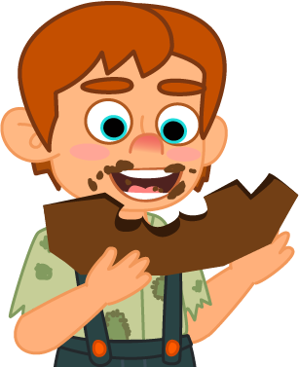
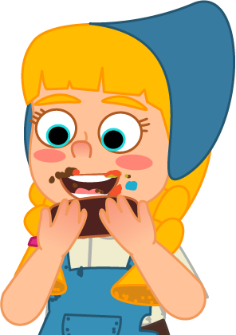
Hansel and Gretel were so hungry that they started to eat the door, the window and the roof.

Slide 9
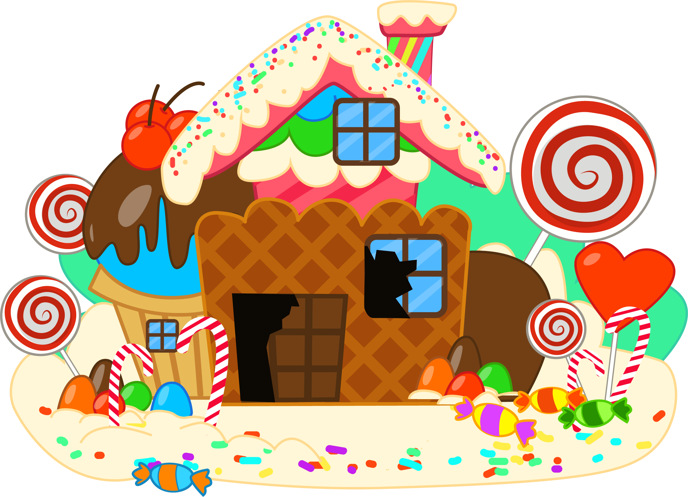
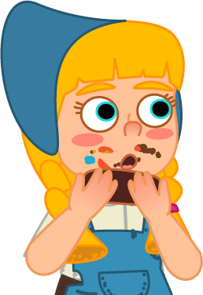
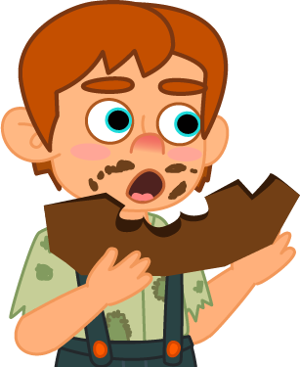

The , whose house it was, caught Hansel and Gretel. These would be her dinner tonight.

Slide 10
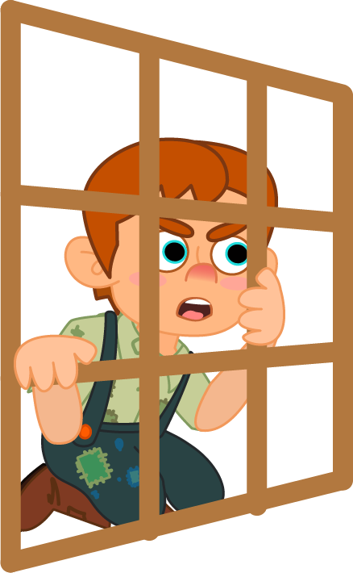
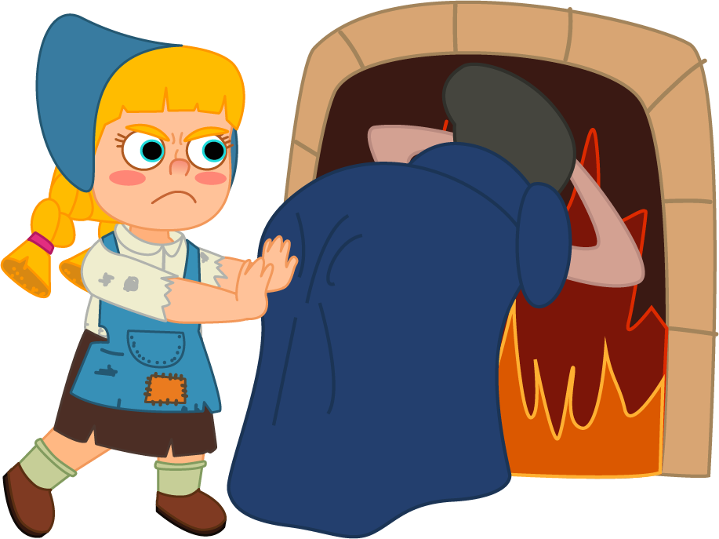
She locked Hansel in a cage and ordered Gretel to heat the oven. But just when the bent down to check the fire, Gretel pushed her from behind and locked the oven door.

Slide 11
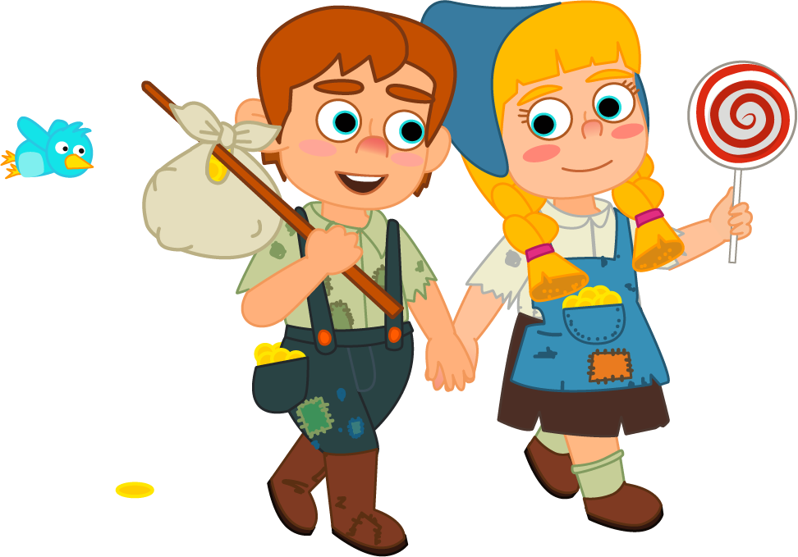
Gretel had saved Hansel and herself! Then, the brother and filled their pockets with the gold.

Slide 12
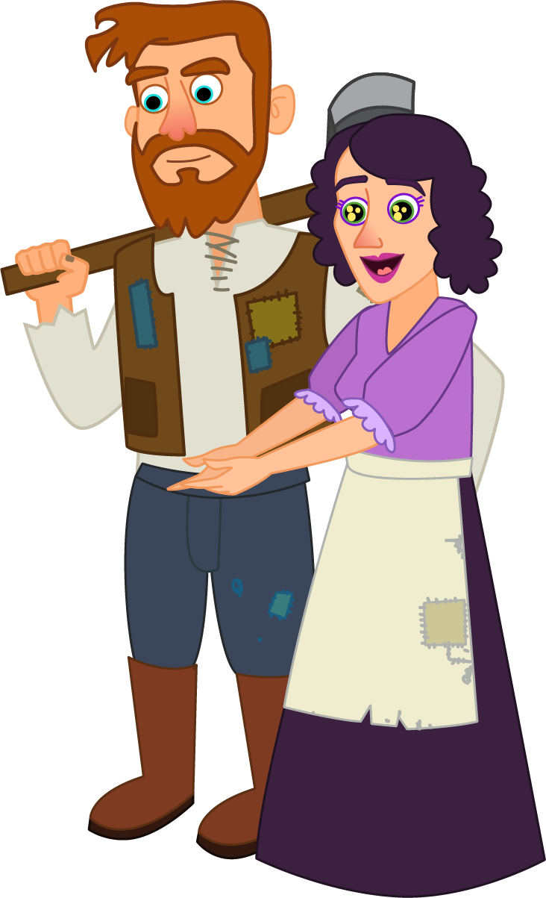
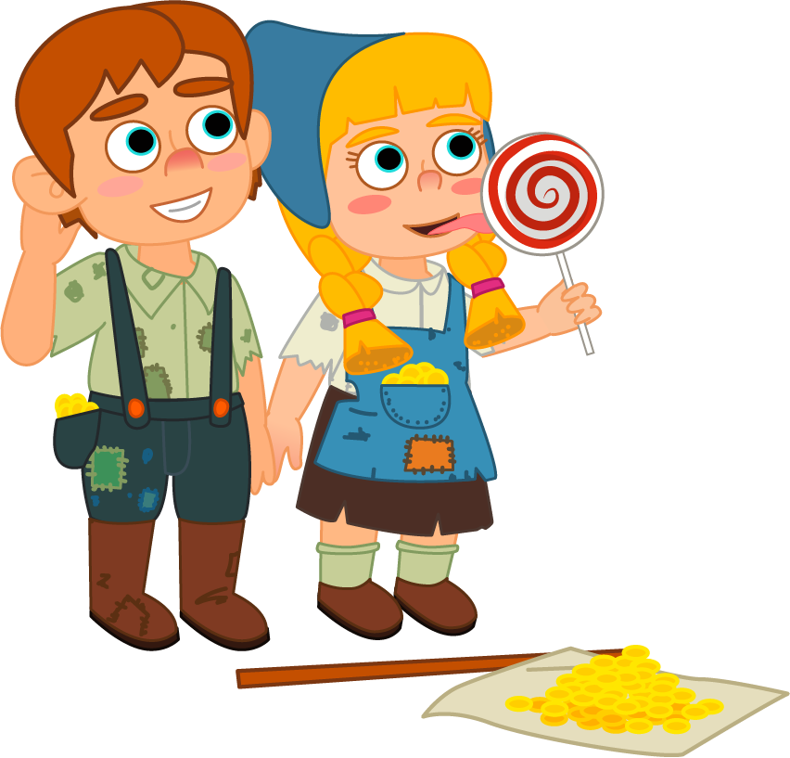

Hansel and Gretel returned home. They gave the gold to their to buy food, and they were never hungry again.

